Slide 1
이벤트 소싱(Event Sourcing) 소개
이규원
gyuwon@live.com
www.facebook.com/gyuwon.yi
justhackem.wordpress.com

Slide 2
이벤트 소싱
이벤트 소싱 핵심 개념

Slide 3
User
Item A
Shopping Cart
Item B
Shopping Cart Item
Item C
Item D

Slide 4
User
Item A
Shopping Cart
Item B
Shopping Cart Item
Item C
Item D

Slide 5
State
Processor
Commands
Logs
Nontransactional

Slide 6
Processor
Commands
Events
Event Handler
State

Slide 7
Events
State
…
User
Item A
…
Shopping Cart
Item B
…
Shopping Cart Item Added Item: C
Shopping Cart Item
Item C
Item D

Slide 8
Events
State
…
User
Item A
…
Shopping Cart
Item B
…
Shopping Cart Item Added Item: C
Shopping Cart Item
Item C
Shopping Cart Item Removed Item: C
Item D

Slide 9
데이터 영속
이벤트 소싱의 데이터 저장과 복원

Slide 10
Event Store
Event Stream
Event Stream
Object Id
Event Stream
Object Id
Object Id
…

Slide 11
Domain Object
Command
Is valid?
Error
No
Yes
Event Store
Raise event
Event

Slide 12

$${State}_{n}=Seed+\sum_{i=1}^{n}{{Event}_{i}}$$

Slide 13
Domain Object
Commands
Command Processor
Events
Event Handler
State
Events
<< Restore >>
Event Store
<< Save >>

Slide 14
Key | Value
Object Id Version | Event Type Serialized Payload

Slide 15
Compound Primary Key
ShoppingCartId | Version | EventType | Payload
b859 | 1 | … | …
b859 | 2 | … | …
b859 | 3 | ShoppingCartItemAdded | { "item_id": "C" }
b859 | 4 | ShoppingCartItemRemoved | { "item_id": "C" }
8d74 | 1 | … | …
8d74 | 2 | … | …
… | … | … | …

Slide 16
백만개의 이벤트를 가지는 도메인 개체

Slide 17
$${State}_{n}=Seed+\sum_{i=1}^{n}{{Event}_{i}}$$

Slide 18
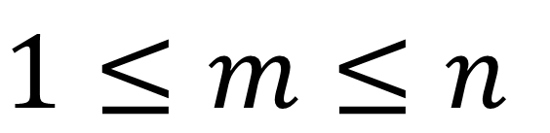
$$1≤m≤n$$

Slide 19
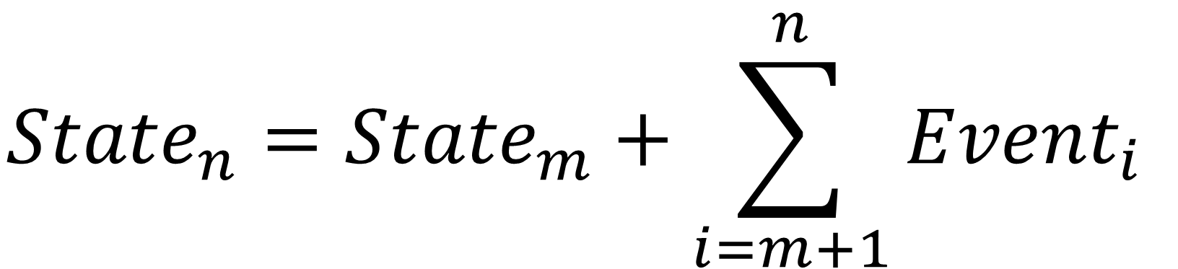
$${State}_{n}={State}_{m}+\sum_{i=m+1}^{n}{{Event}_{i}}$$

Slide 20
Event N
Event N - 1
Event N - 2
Snapshot N - 2
…
Event 3
Event 2
Event 1

Slide 21
Key | Value
Object Id | Version Serialized State

Slide 22
메시징
이벤트 소싱과 메시지 중심 설계

Slide 23
Service
Service
Commands
Messages

Slide 24
There are only two hard problems in distributed systems: 2. Exactly-once delivery 1. Guaranteed order of messages 2. Exactly-once delivery
- Mathias Verraes

Slide 25
Event Store
Domain Object
Event Queue

Slide 26
Event Stream
Event Stream
Partition
Consumer
Event Stream
Event Stream
Partition
Consumer
Message Broker

Slide 27
CQRS
이벤트 소싱과 CQRS 패턴 조합

Slide 28
“재고가 10개 미만인 상품 목록이 필요합니다.”

Slide 29
Command
Query
Separation

Slide 30
Command
Query
Responsibility
Segregation

Slide 31
System
Command Side
Query Side

Slide 32
Command Side
Query Side
Event Store
Materialized View
Events
Domain Layer
Read Model Facade
Commands
Queries
Results
Client

Slide 33
Domain A
Event Store
Domain B
Event Store
Relational
Read Model
Domain C
Event Store

Slide 34
Relational
Event Store
Key-Value
OLAP

Slide 35
고려사항
이벤트 소싱 사용시 고려해야할 것들

Slide 36
익숙하지 않음
가파른 학습 곡선
비동기와 최종 정합(eventual consistency)
과도한 엔지니어링
유일성 제약
도구의 부족

Slide 37
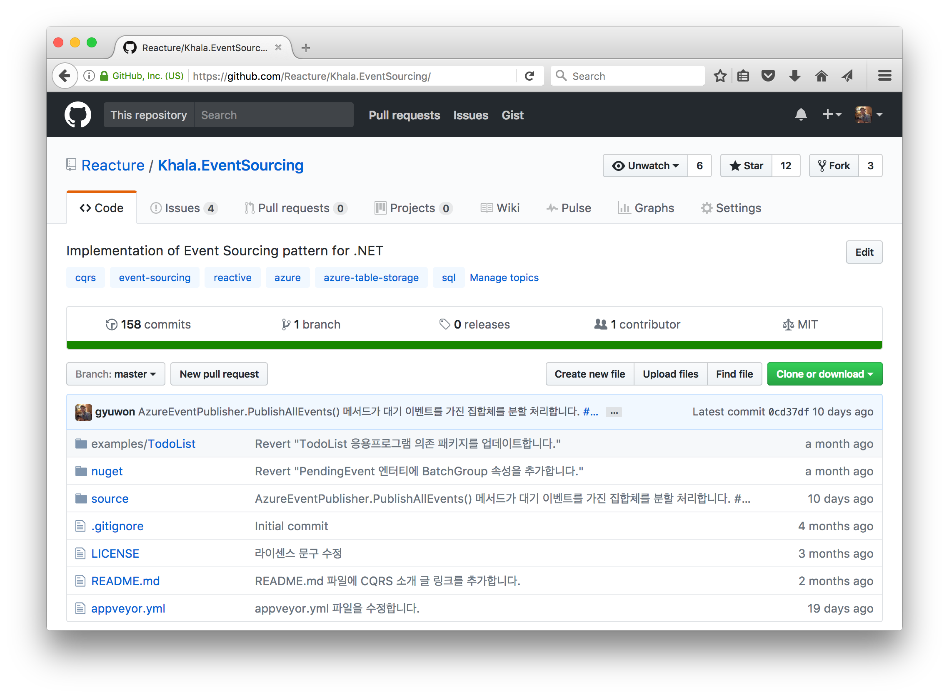
https://github.com/Reacture/Khala.EventSourcing/
이벤트 소싱 구현체
.NET
nuget
Khala.EventSourcing.Core
Khala.EventSourcing.Sql
Khala.EventSourcing.Azure
유일성 제약
문자열 속성
SQL 이벤트 저장소

Slide 38
이벤트 소싱 Java 구현체 프로젝트

Slide 39
질문 및 답변

